Slide 1
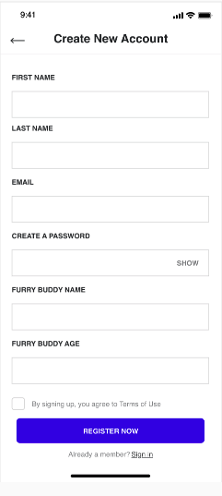
Register
DB Structure Table Name = tbl_members
Id (primary key) (Int)
first_name (varchar 255)
last_name (varchar 255)
mobile (varchar 10)
email (varchar 255) *Unique
password (varchar 255) *Encoded
furry_buddy_name (varchar 255)
furry_buddy_age (varchar 255)
furry_buddy_type (varchar 255)
furry_buddy_special_notes (text)
status
date_created
Notes
If one or more fields are not completed, a red error message is inserted above the problematic field: “Please complete ‘field name” ”.
If the terms and conditions box is not ticked, we add this text to the message: “Please accept the terms and conditions to continue”
Password complexity: Upper case, special character and number to be used
Cell phone validation for 10 digits (Numeric)
Email validation for email address (@ sign)
Complete Sign up form
Validate Entries
Pass
Y
Call Login API & Write to DB
Register
Highlight Invalid Fields
N

Slide 2
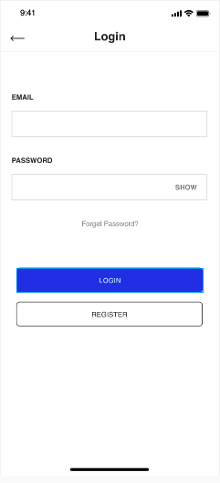
Login
Notes
When the user clicks Sign In, the following checks should be performed on the server:
If the email address was provided, but it is not a real email address because it is not formatted correctly (e.g. there is no @ sign or it contains characters that are not permitted in email addresses), a red error message is inserted above the email box, saying “The email address you have provided is not valid. Please check it.”
If the email address was provided, but it does not correspond to a registered member, a red error message is inserted above the email box, saying “The email address you have provided is not a member. To become a member, click on “Register”
If the email address was provided, and it does correspond to a registered member, and a password was provided, but the password is incorrect, a red error message is inserted above the password box, saying “The password you provided is not valid. Please double check it. Remember, passwords are case-sensitive.”
If the password typed does not contain any lower case alphabetic characters, we add this text to the message: “Perhaps you’ve accidentally turned on CAPS LOCK?”
Whenever the password is incorrect, the Sign In Form comes back with the password box clear.
If the email address and password are correct, go straight to home page.
Reset Password
Login
Y
User Insert Email
Email User Code
Reset Password
N
Reset Password
Insert Unique Code

Slide 3
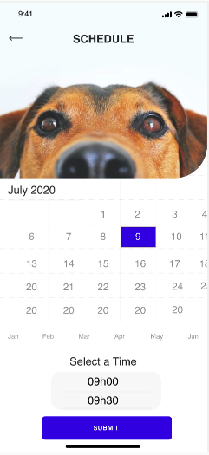
Schedule
DB Structure Table Name = tbl_scheduled
Id (primary key) (Int)
customer_id
message_title
full_description
date_created
Notes
Member should be able to amend the following details
FIRST NAME
LAST NAME
EMAIL
MESSAGE TITLE
FULL DESCRIPTION
Data should be written to the database and an email sent to the Dog Walking admin
If one or more fields are not completed, a red error message is inserted above the problematic field: “Please complete ‘field name” ”.
Complete Contact Form
Validate Fields
Pass
Y
Email Sent to DW Admin
CONTACT US
Highlight Invalid Fields
N

Slide 4
Account Settings
Notes
Member should be able to amend the following details
FIRST NAME
LAST NAME
EMAIL
PASSWORD
ADD/REMOVE FURRY BUDDIES
FURRRY BUDDY DETALIS

Slide 5
Contact Us
DB Structure Table Name = tbl_contact_us
Id (primary key) (Int)
customer_id
message_title
full_description
date_created
Notes
Member should be able to amend the following details
FIRST NAME
LAST NAME
EMAIL
MESSAGE TITLE
FULL DESCRIPTION
Data should be written to the database and an email sent to the Dog Walking admin
If one or more fields are not completed, a red error message is inserted above the problematic field: “Please complete ‘field name” ”.
Complete Contact Form
Validate Fields
Pass
Y
Email Sent to DW Admin
CONTACT US
Highlight Invalid Fields
N

